Slide 1


TRANSPORTATION OPTIMIZATION PROJECT
Minimizing Logistics Costs through Linear Programming and Data-Driven Analysis
Manus AI | January 2026

Slide 2


PROJECT OVERVIEW
Minimizing Costs through Structured Optimization
Primary Objective
Minimize total transportation costs while satisfying all supply and demand constraints across the network.
Two-Step Methodology
Starting with a deterministic model and extending it for scenario variation analysis.
Mathematical Foundation
Linear programming provides the framework for optimizing shipment allocations from multiple origins to destinations.
Operational Efficiency
Structured framework ensures data-driven decision-making for complex logistical challenges.

Slide 3
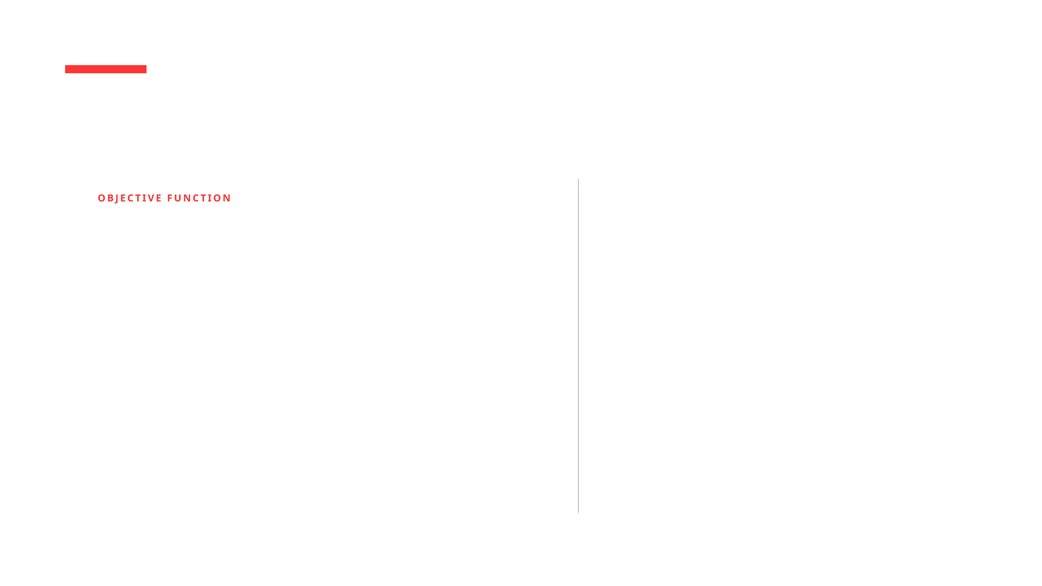
METHODOLOGY: MODEL FORMULATION
Variables, Objectives, and Operational Constraints
Operational Constraints
OBJECTIVE FUNCTION
Minimize Z = Σ Σ c_ij * x_ij
Supply: Total shipments from each origin cannot exceed its maximum capacity (S_i).
Demand: Each destination must receive its minimum required quantity (D_j).
Decision Variables
Non-Negativity: All shipment quantities must be greater than or equal to zero.
x_ij: Quantity transported from supply node i to demand node j.
Balanced Problem: Total Supply = Total Demand (2,300 units).
c_ij: The cost of moving one unit of product along a specific route.

Slide 4
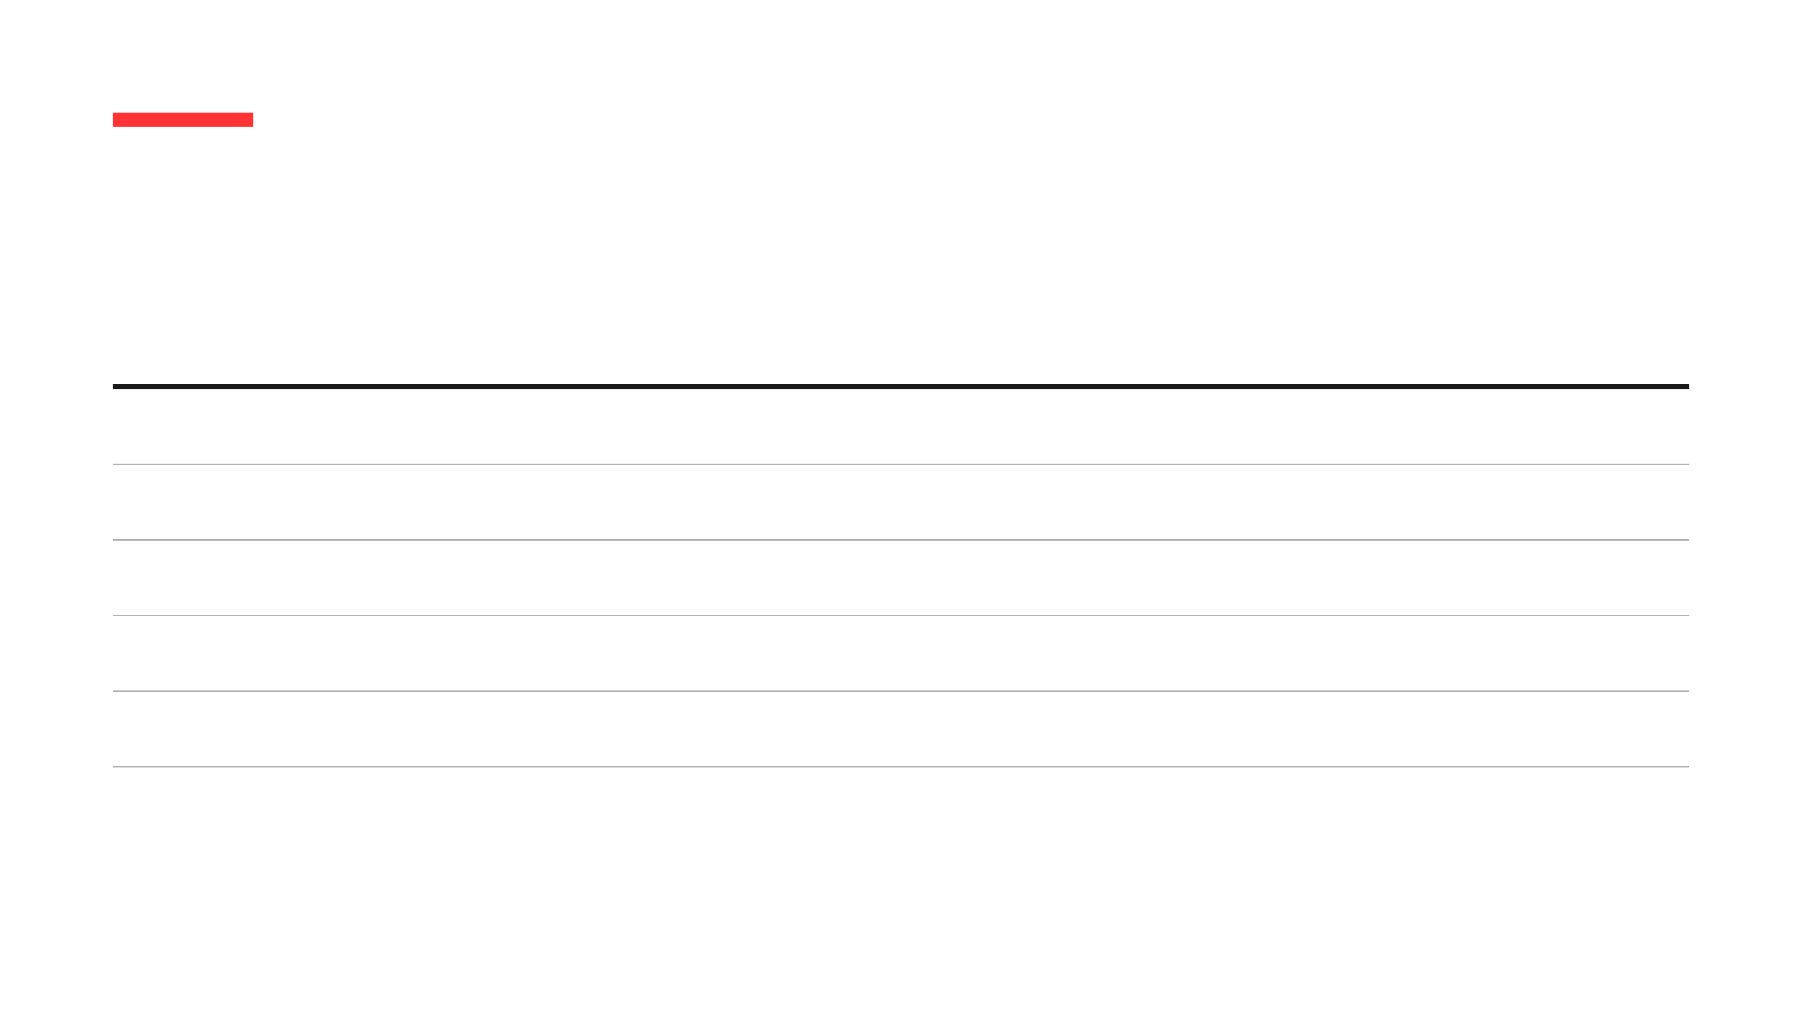
SUPPLY NODE CAPACITIES
Total Network Capacity: 2,300 Units
Node ID
Location
Capacity (Units)
S01
Chicago
500
S02
Dallas
450
S03
Atlanta
400
S04
Seattle
550
S05
New York
400
TOTAL
-
2,300

Slide 5
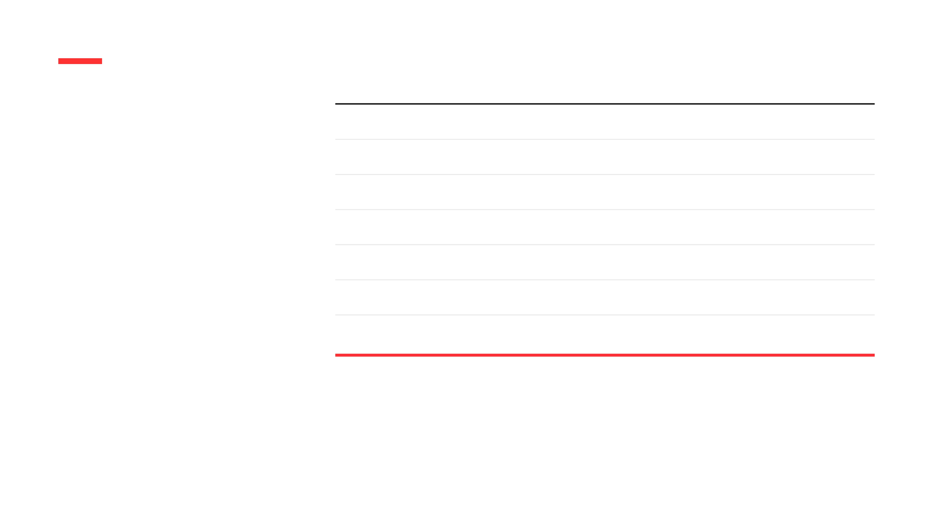
Node ID
Location
Requirement (Units)
DEMAND NODE REQUIREMENTS
D01
Los Angeles
400
D02
Miami
300
Total Network Demand: 2,300 Units
D03
Denver
450
D04
Houston
350
D05
Phoenix
450
D06
Boston
350
TOTAL
-
2,300

Slide 6
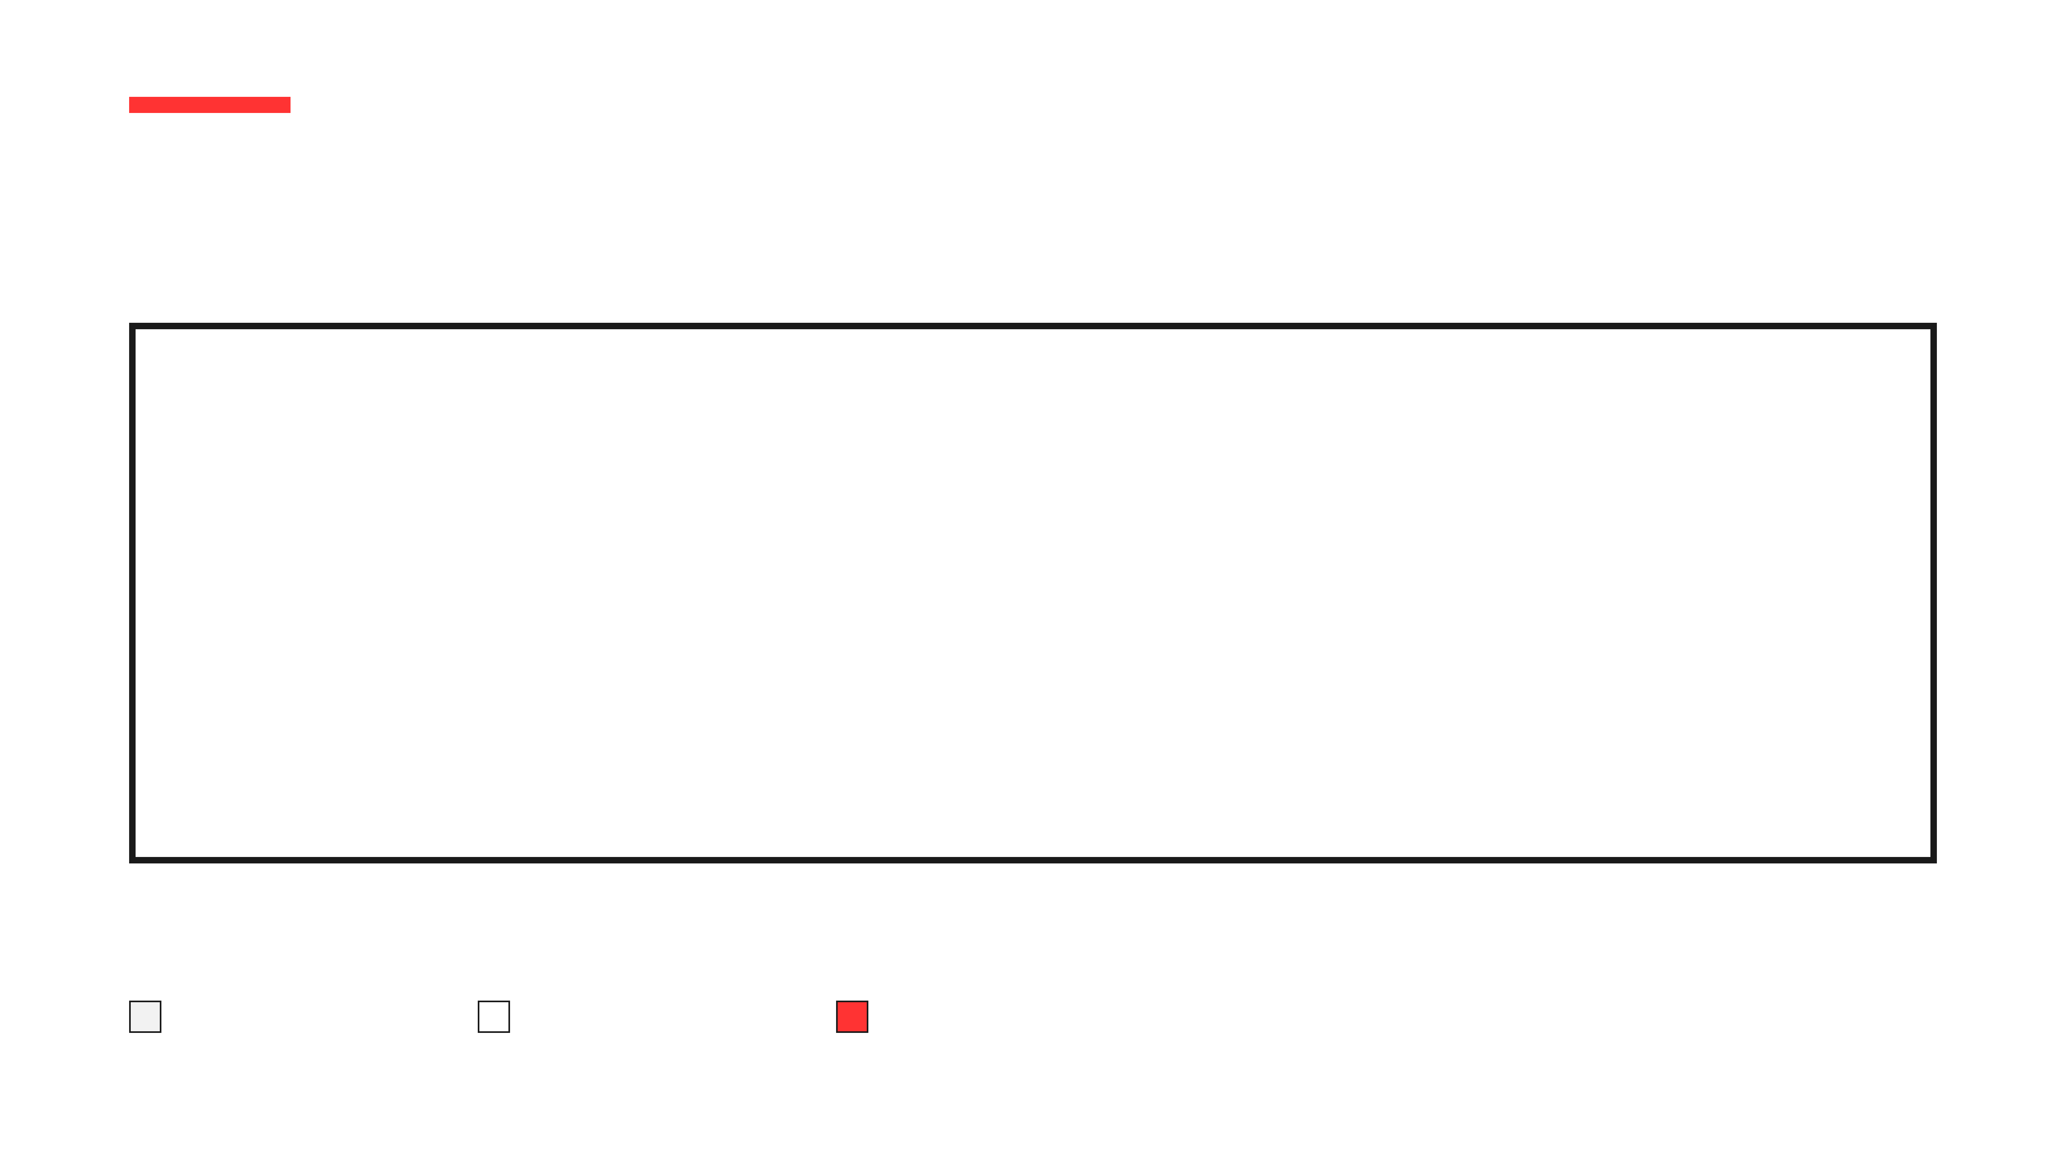
UNIT COST MATRIX ($/UNIT)
Identifying Low, Mid, and High Cost Routes
ORIGIN
D01
D02
D03
D04
D05
D06
S01
15.0
22.0
12.0
18.0
10.0
25.0
S02
18.0
14.0
15.0
8.0
12.0
10.0
S03
20.0
9.0
16.0
10.0
18.0
12.0
S04
10.0
25.0
5.0
18.0
8.0
22.0
S05
24.0
12.0
20.0
15.0
22.0
7.0
LOW COST ($5-$10)
MID COST ($11-$19)
HIGH COST ($20+)

Slide 7


SOLVER LOGIC: THE OPTIMIZATION PROCESS
From Data Ingestion to Optimal Output
01
02
Data Ingestion
Model Mapping
Loading supply capacities, demand requirements, and the unit cost matrix into the PuLP framework.
Defining the objective function and translating operational constraints into mathematical inequalities.
03
04
Iterative Solving
Optimal Output
The CBC solver executes the Simplex algorithm to navigate the feasible region and find the global minimum.
Extracting the final shipment quantities and total cost for operational implementation.

Slide 8

KEY FINDINGS: COST EFFICIENCY
Achieving Global Minimum Cost
$23,350
$13,373
Total Optimized Cost
Estimated Savings
Network Balance
Average Unit Cost
The model successfully balanced 2,300 units of total supply with 2,300 units of total demand.
Achieved an average unit cost of $10.15 across all active shipment routes.

Slide 9


ROUTE ANALYSIS: EFFICIENCY & VOLUME
Prioritizing Low-Cost Corridors
01
Efficiency Leaders
The model prioritized S04 to D03, moving 400 units at the lowest unit cost of $5.00.
02
High-Volume Corridors
Major flows were established from S01 to D05 and S02 to D06, each handling 350 units.
03
Strategic Allocation
Higher-cost routes are only utilized when necessary to satisfy demand constraints, ensuring maximum cost avoidance.

Slide 10

MAPPING SHIPMENT FLOW
Optimal Shipment Distribution
Corridor Identification
The optimization reveals the primary transportation corridors selected by the model to minimize total expenditure.
Cost Avoidance
High-cost routes are systematically bypassed, with shipments concentrated in the most efficient lanes.
Optimal Distribution
Visualizing the flow of 2,300 units across the network to achieve the $23,350 minimum cost.

Slide 11


UTILIZATION & PERFORMANCE
100% Efficiency in Supply and Demand
100%
Supply Capacity
Every supply node is leveraged to the maximum operational limit. All 2,300 units of available capacity are actively contributing without waste.
100%
Demand Fulfillment
All destination requirements are met with precision. Each of the 6 demand nodes receives the exact specified quantity, maintaining high service levels.

Slide 12
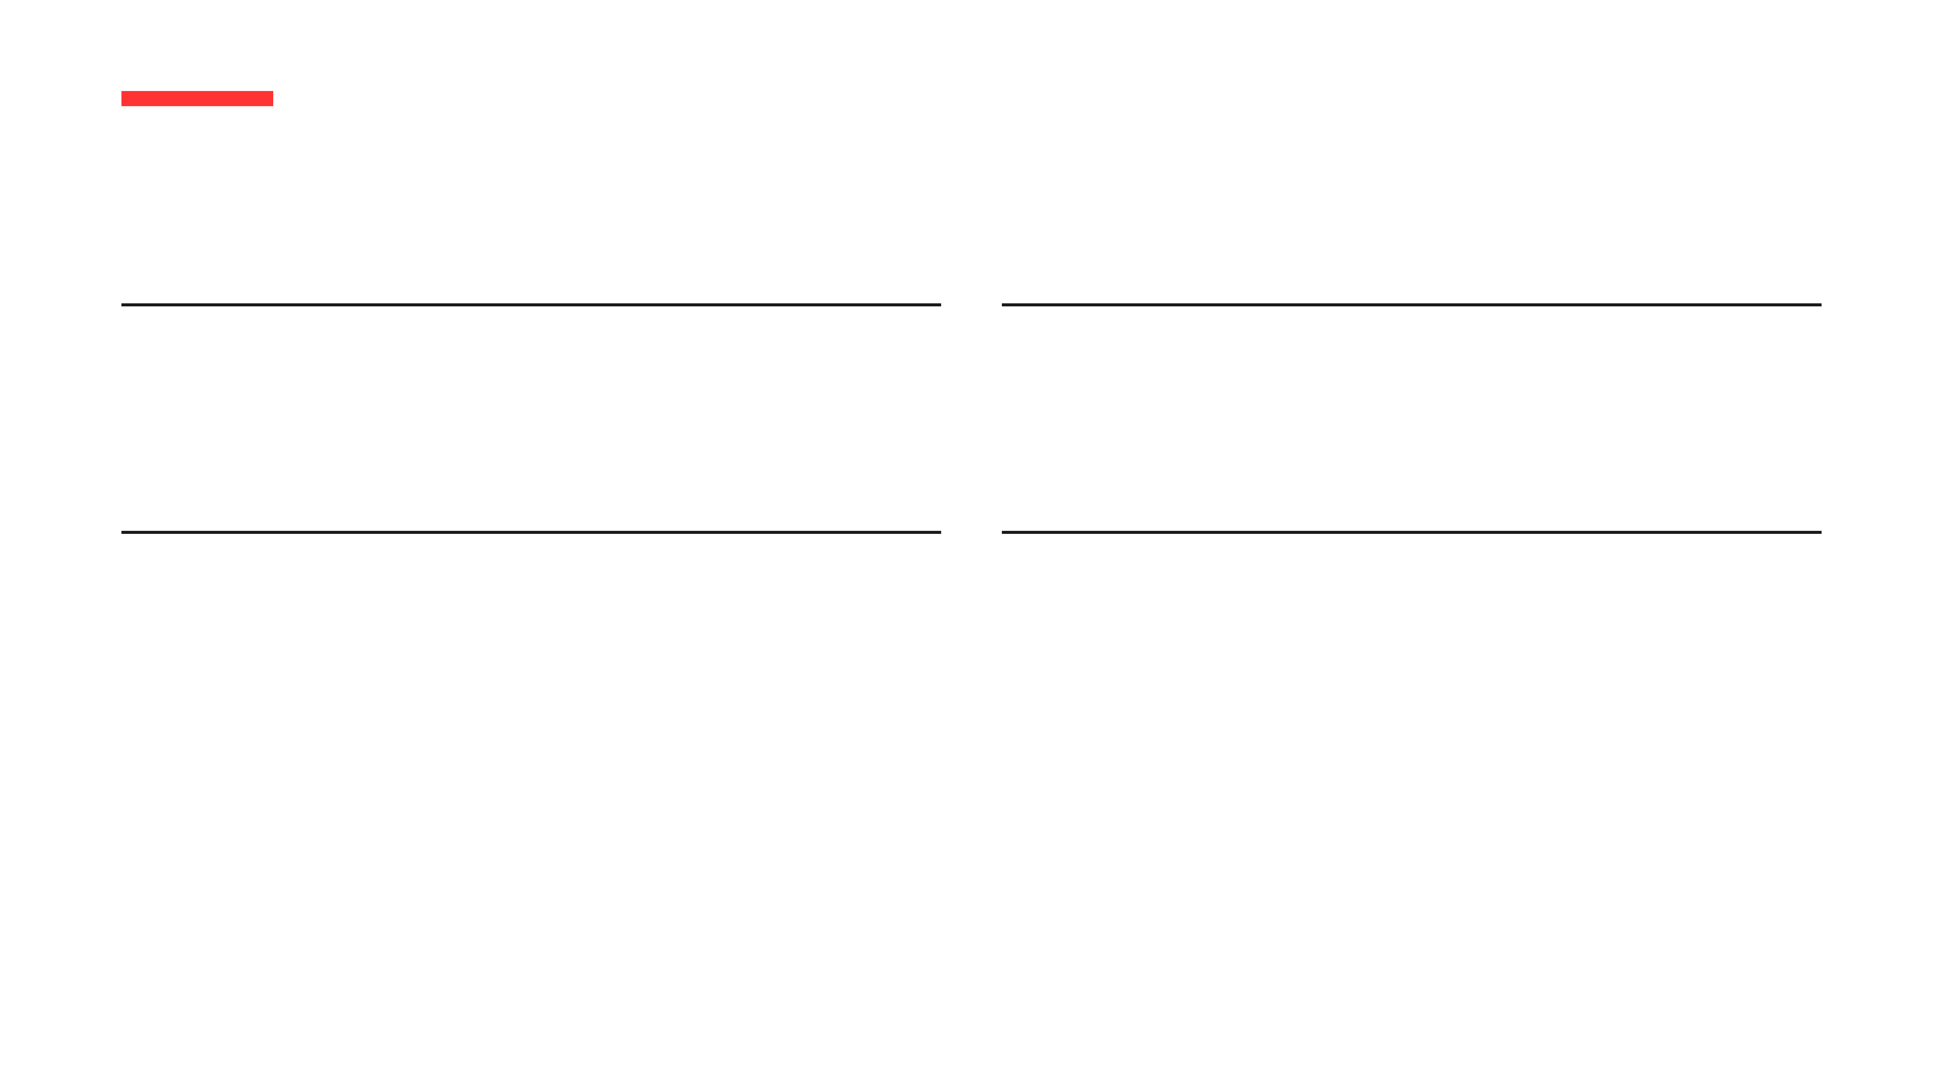
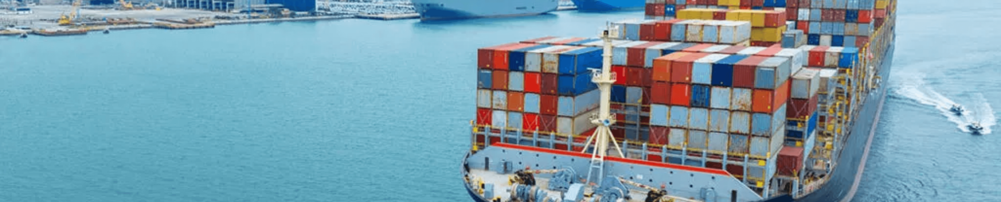
STRATEGIC VALUE OF OPTIMIZATION
Optimizing Today for a More Efficient Tomorrow
Efficiency
Scalability
Linear programming transforms complex logistical variables into a clear, cost-minimized operational plan.
The framework is easily adaptable to include new supply nodes, changing demand, or fluctuating costs.
Savings
Insight
Data-driven allocation identifies hidden efficiencies, resulting in significant and measurable cost reductions.
Advanced visualization and analysis provide stakeholders with actionable intelligence for supply chain strategy.

Slide 13

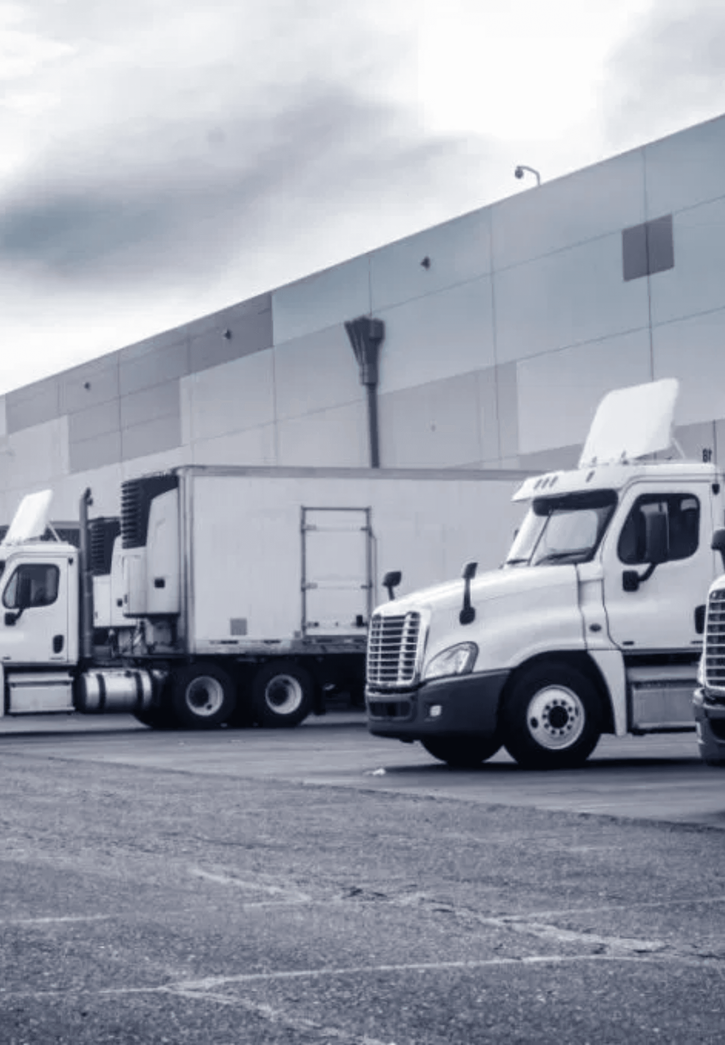
EFFICIENCY DRIVERS
Strategic Allocation and Cost Avoidance
Low-Cost Corridors
The model prioritized routes such as S04 to D03, which operates at just $5.00 per unit.
Strategic Cost Avoidance
Systematically bypassing high-cost routes across the network to minimize expenditure.
High-Efficiency Lanes
Volume was concentrated in the most efficient lanes, maximizing the impact of every transportation dollar spent.

Slide 14

EXECUTIVE SUMMARY: FINANCIAL IMPACT
Achieving $13,373 in Estimated Savings
$13,373
$23,350
Total Savings
Optimized Cost
The linear programming model successfully reduced the total logistics budget by identifying the global minimum cost while satisfying all network constraints. This represents a significant improvement over non-optimized benchmarks.

Slide 15

THANK YOU
TRANSPORTATION OPTIMIZATION PROJECT
Questions?

